Slide 1


Бережний, Лобода, Чухманенко
WORK-CASE 4
Memento Mori

Slide 2
"package" and "repository"
PACKAGE
REPOSITORY
is an archive that contains software, libraries, or files with instructions needed to install and configure a program on an operating system.
a special server on which the software is stored and from which it can be downloaded. An archive of software products that are available for download is stored on the server. This is the place where any data is stored and maintained.

Slide 3

Package managers
APT (Advanced Package Tool)
Snap
a utility for installing, updating, and removing software packages on and based on Debian operating systems. Apt is also used in some distributions based on the RPM package manager, such as Mandriva and ALT Linux.
self-contained applications that run in sandbox mode with indirect access to the host system. Snap was originally released for cloud applications, but was later ported to IoT devices as well as desktop applications.
dpkg (Debian Package)
software that is the backbone of Debian's package management system. dpkg is used to install, remove, and retrieve information about . deb packages.

Slide 4
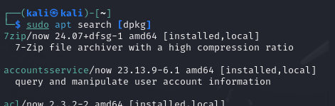
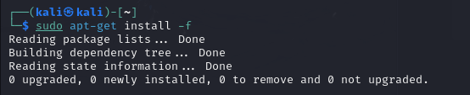
Installation package manager #1
Дізнаємося який в нас менеджер пакетів
Встановлюємо інший менеджер пакетів

Slide 5
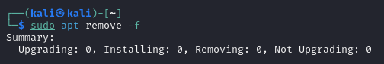
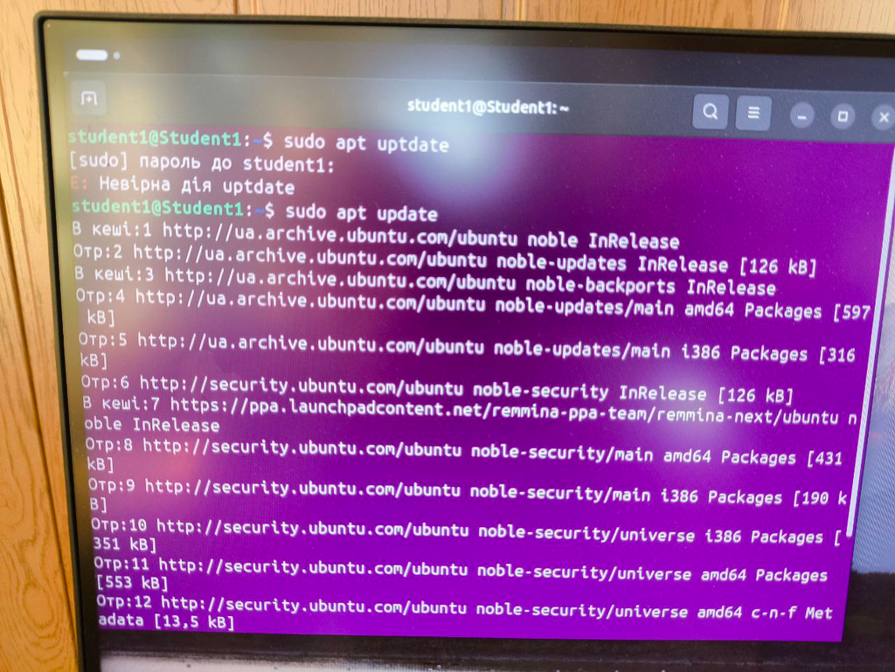
Installation package manager #2
Видалення непотрібних або застарілих пакетів
ОНОВЛЕННЯ МЕНЕДЖЕРА ПАКЕТІВ

Slide 6
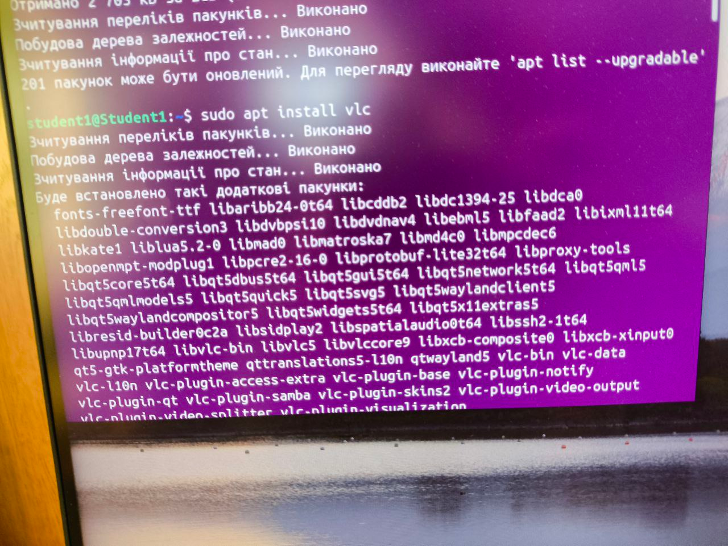
Встановіть у терміналі відеоплейер.
Встановили

Slide 7
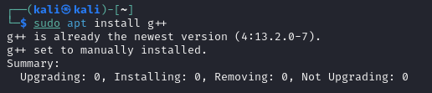
Встановіть С++
Встановили

Slide 8
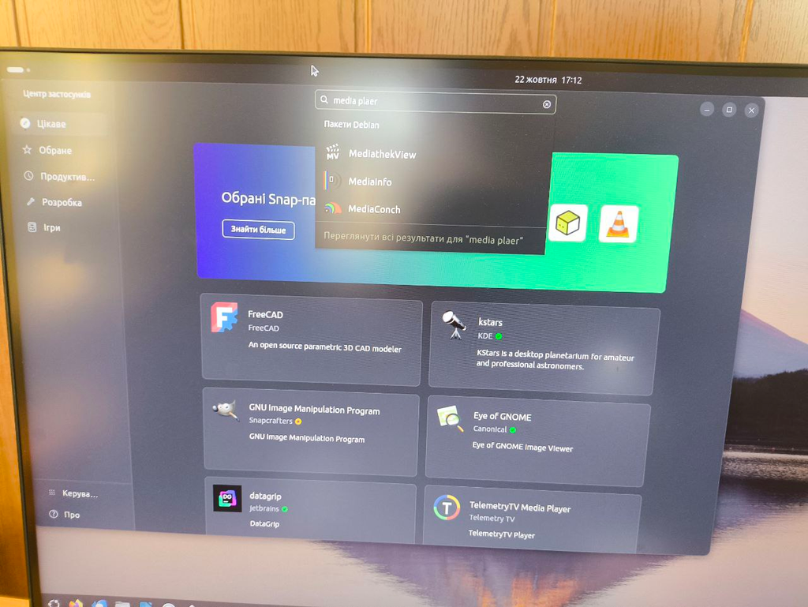
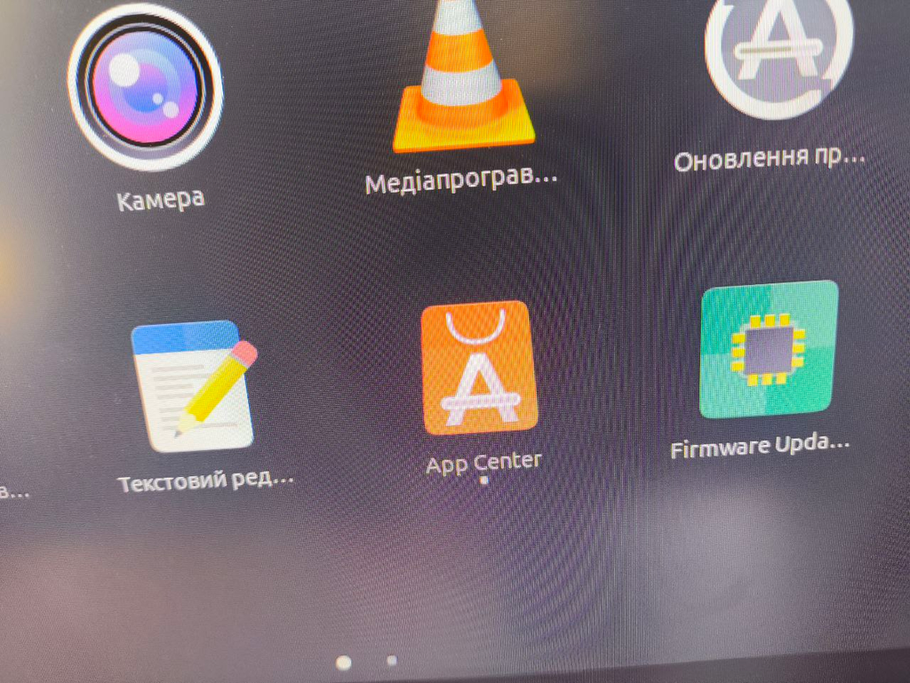
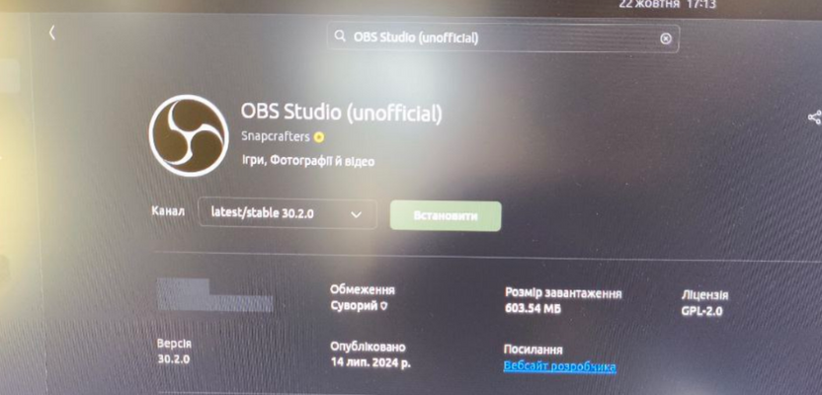
Скачати через маркет плейс програму
Шукаємо те, що на потрібно
Заходимо сюди
Встановлюємо

Slide 9
LET’S WORK

